Slide 1
Grant Writing for Success
June 28th, 2018
Jill Morris PhD
jill.morris@nih.gov

Slide 2
Brief History
1997-1998: Senior Staff Fellow, Developmental and Metabolic Neurology Branch, NINDS, NIH, Bethesda, MD.
Research: Niemann-Pick Type C
1998-2003: Senior Research Biologist, Department of Neuroscience, Merck Research Laboratories, Merck & Co., West Point, PA.
Research: Alzheimer’s, Parkinson’s, Bipolar Disorder and Schizophrenia
2003 to 2011: Assistant Professor of Pediatrics, Northwestern University and Children’s Memorial Research Center, Chicago, IL.
Research: Molecular Basis of Neurodevelopmental Disorders including autism and schizophrenia
2011 to present: Program Director, Neurogenetics, NINDS, NIH.
Promote interactions between investigators with different expertise to drive translation

Slide 3
My Role
Act as an advocate for a scientific area
  Interact with investigators and facilitate funding
  Interact with advocacy
  Identify gaps in portfolio
  Hold workshops
Oversee grant portfolios
Administer NIH's scientific programs
Set priorities for committing federal funds
Interact across the NIH – e.g., Hydrocephalus Trans-NIH Working Group, NF Trans-NIH Working Group, ECHO
Grant mechanisms – Training (Fs and Ks), Research (Rs), Program Projects (P01s), Cooperative Agreements (Us), Small Business Grants (SBIRs/STTRs), RDCRNs, Clinical Trials and Conference Grants
3

Slide 4
Overview
Step 1: Understand how NIH works
  Finding the right fit for your research
Step 2: Find a funding opportunity
  Searching for and understanding FOAs
Step 3: Plan your application
  Who to talk to when about what
Step 4: Write your grant application
  Some do’s, don’ts, and pointers
Notes:
Funding Opportunity Announcement

Slide 5
Navigating NIH
From concept to award

Slide 6

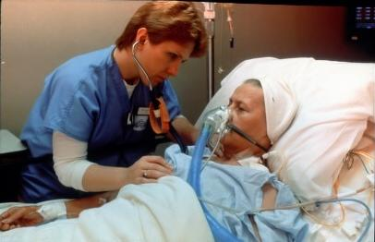
The National Institutes of Health
The Nation’s Steward of Medical, Behavioral, & Social Sciences Research
NIH Mission:
To seek fundamental knowledge about the nature and behavior of living systems and the application of that knowledge to enhance health, lengthen life, and reduce illness and disability.
...
Notes:
[Animated, 1 click]

Slide 7
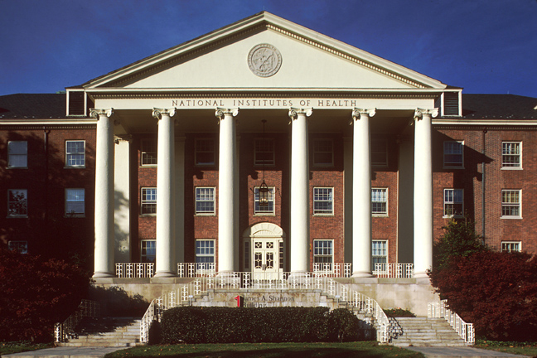
National Institutes of Health
One agency of 11 within U.S. Department of Health and Human Services (HHS)
Comprises 27 Institutes and Centers (ICs)

Slide 8





















National Institutes of Health
Office of the Director
National Institute
on Aging
National Institute
on Alcohol Abuse
and Alcoholism
National Institute
of Allergy and
Infectious Diseases
National Institute
of Arthritis and
Musculoskeletal
and Skin Diseases
National Cancer
Institute
National Institute
of Child Health
and Human
Development
National Institute on
Deafness and Other
Communication
Disorders
National Institute
of Dental and
Craniofacial
Research
National Institute
of Diabetes and
Digestive and
Kidney Diseases
National Institute
on Drug Abuse
National Institute
of Environmental
Health Sciences
National Eye
Institute
National Institute
of General
Medical Sciences
National Heart,
Lung, and Blood
Institute
National Human
Genome Research
Institute
National Institute
of Mental Health
National Institute
of Neurological
Disorders and
Stroke
National Institute
of Nursing Research
National Center on
Minority Health
and Health
Disparities
National Center
for Complementary
and Alternative
Medicine
Fogarty
International
Center
National Center
for Advancing
Translational
Sciences
National Library
of Medicine
National Institute
of Biomedical
Imaging and
Bioengineering
NIH
Clinical Center
Center
for Information
Technology
Center
for Scientific
Review
Notes:
27 I/Cs, 24 of whom award grants

Slide 9






















27 Institutes and Centers (IC)
Each with a different:
  mission & priorities
  budget
  funding strategy
NIGMS
International Center

Slide 10

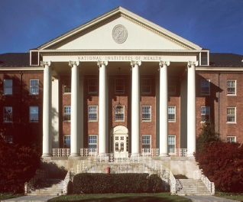



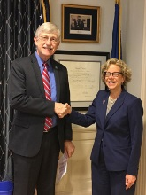
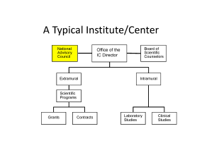
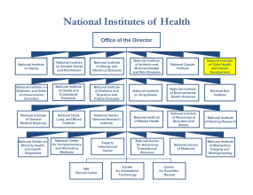
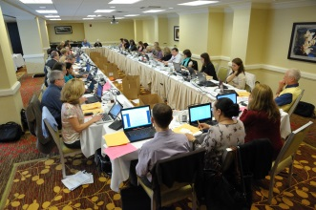
Life Cycle of a Grant
Research Team
Institution
NIH
Idea
Center for Scientific Review
Institute Director
Advisory Council
Assigns to IC/review group
Institute
Study Section
Funds
Takes final action
Recommends action
Evaluates
program
relevance
Reviews
scientific
merit

Slide 11
Funding opportunities
What are your options?

Slide 12

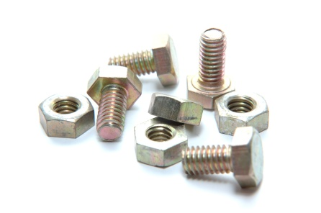
Research Projects
Small Business
Training & Career Development
Research Centers
What’s the Right Type of Grant for My Idea (and Me)?

Slide 13
Research Training and Career Development Timeframe
Research Awards
Career Stage
‘Formal’ Training/Career Awards
Pre-Bac
Pre-Bac Institutional Training Grant (T34)
GRADUATE/
MEDICAL
STUDENT
Predoctoral Institutional Training Grant (T32)
‘Informal’ Training
and Career
Development on
RPGs and
Supplements
Predoctoral Individual NRSA (F31)
Predoctoral Individual MD/PhD NRSA (F30)
Postdoctoral Institutional Training (T32)
Postdoctoral Individual NRSA (F32)
POST
DOCTORAL
NIH Pathway to Independence (PI) Award (K99/R00)
Mentored Research Scientist Development Award (K01)
Mentored Clinical Scientist Development Award (K08)
Mentored Patient-Oriented RCDA (K23)
Mentored Quantitative RCDA (K25)
Institutional Mentored Clinical Scientist Award (K12)
EARLY
Small Grant (R03)
AREA Grant (R15)
Exploratory/Develop-ment Grant (R21)
CAREER
MIDDLE
Research Project Grant (R01)
Midcareer Investigator Award in
Patient-Oriented Research (K24)
SENIOR
Senior Scientist Award (K05)

Slide 14

Funding Opportunities
Advertised through
  NIH Guide for Grants and Contracts
    grants.nih.gov
Issued by
  Each IC
  “Parent” announcements span the breadth of the NIH mission, include many ICs

Slide 15
Know the terminology:
Funding Opportunity Announcements (FOA)
Type of FOA | Description
Parent Announcements | Allow for investigator-initiated applications For specific activity codes (R01, R03, etc.) Many ICs participate (cover all NIH interest areas) Usually ongoing (3 years); use standard due dates
Program Announcements (PA) | Issued by 1 or more ICs to highlight interest in a scientific topic Usually ongoing and use standard due dates For PA with special receipt, referral, and/or review (PAR) review may be in a specific IC or a CSR special emphasis panel (SEP)
Requests for Applications (RFA) | Issued by 1 or >1 IC to highlight a specific area of scientific interest and achieve program objectives Uses set-aside funds and usually a single due date IC usually convenes review panel

Slide 16
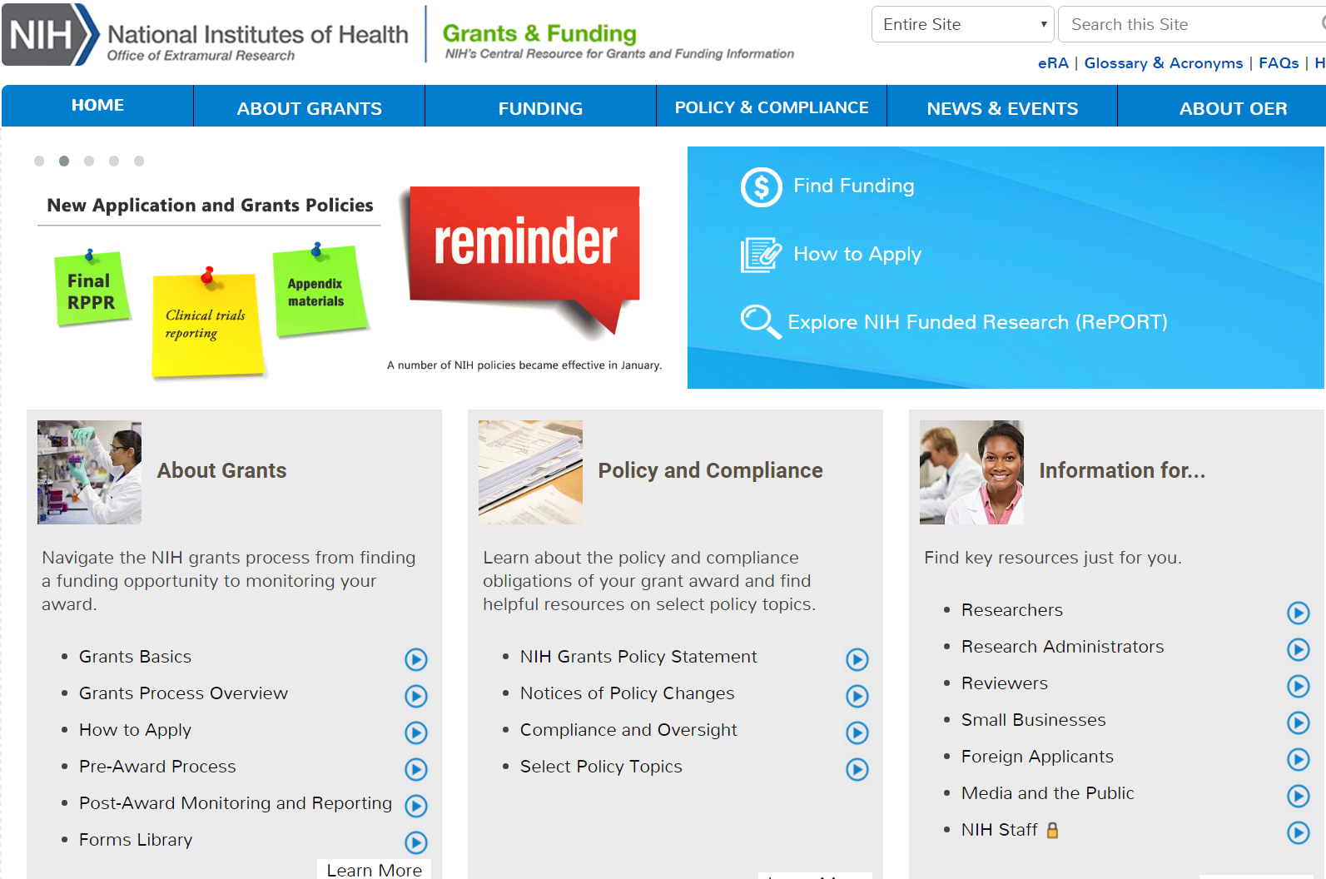
https://grants.nih.gov

Slide 17
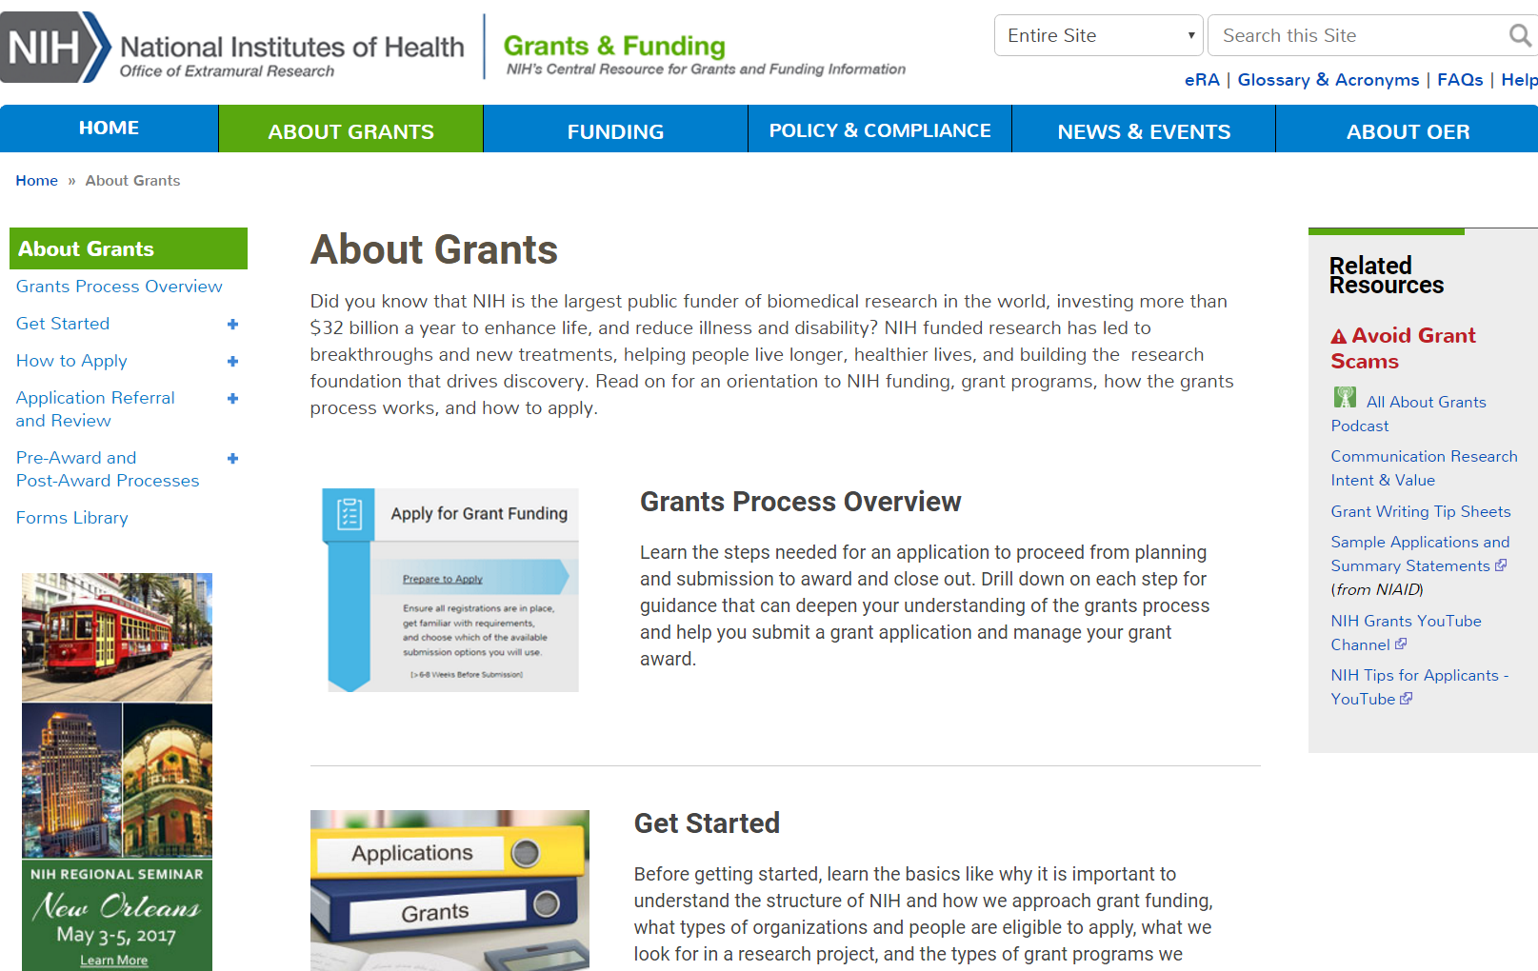
https://grants.nih.gov

Slide 18
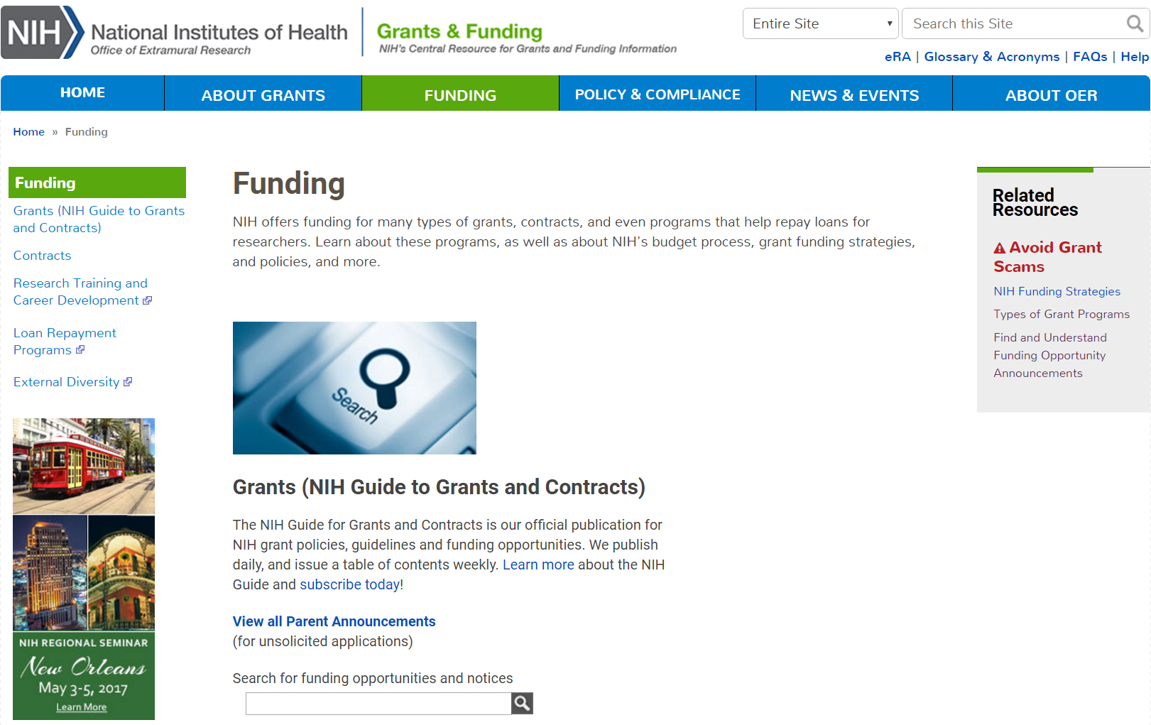
https://grants.nih.gov

Slide 19
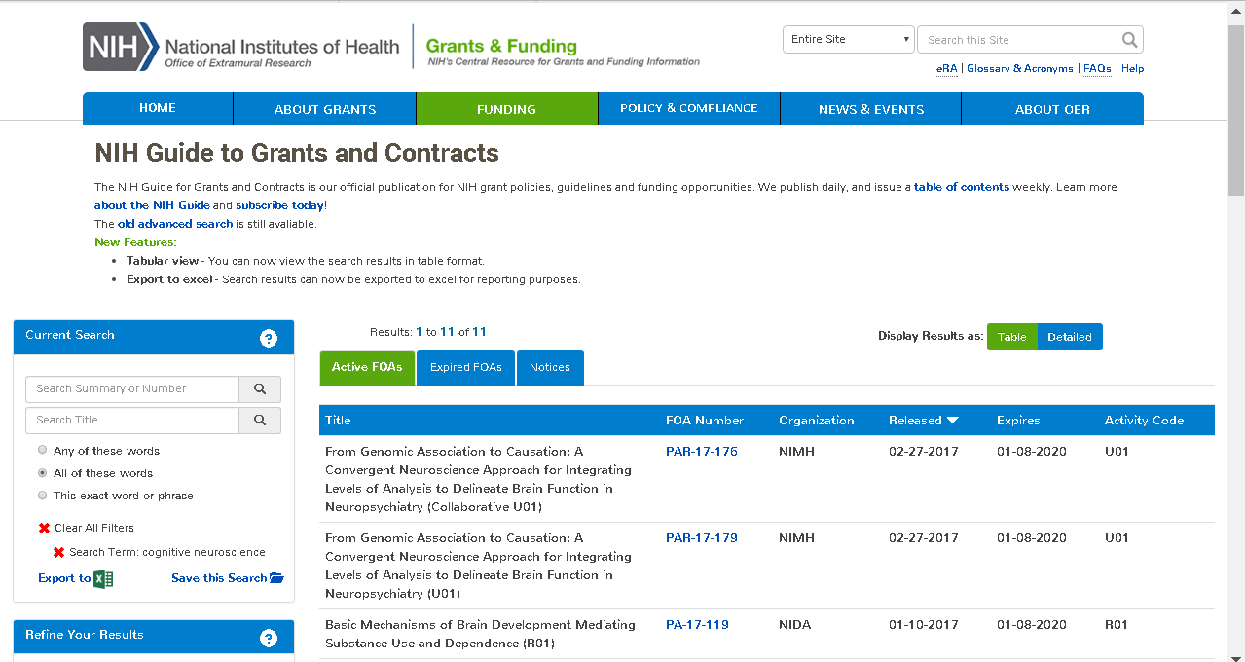
https://grants.nih.gov

Slide 20
You have an idea or plan
Now what?

Slide 21
Pre-submission planning timeline
Planning
Writing
Submitting
Months Prior
8 7 6 5 4 3 2 1 mo.
Assess
yourself, field, & resources
Receipt
Date
Outline application structure; write your application
Set up own review committee; determine human & animal subject requirements
Meet institutional deadlines
Brainstorm; research idea; call NIH staff
Get feedback; edit & proofread
Notes:
Don’t wait until 2 weeks before to contact institute about relevance

Slide 22
Where to start
Complete/renew required registrations (Start now!)
  Institutions - required to register in multiple systems
  Investigators - must register in the eRA Commons
Develop the application
  Download application forms from funding opportunity announcement
  Carefully read the funding opportunity and application instructions to be sure you submit a responsive application.
Learn about the electronic application submission process well before the application due date

Slide 23
Know your PD, SRO, and GS
Program Director (PD) (aka PO)
  Works in a particular institute
  Manages a scientific research portfolio of grants, contracts, and cooperative agreements
Scientific Review Officer (SRO)
  Typically works in CSR but also within institutes
  Helps ensure that the scientific review group (study section) identifies the most meritorious science for potential funding
  Grants Management Specialist/Officer (GS/GMO)
    Works in a particular institute; Evaluates applications for administrative content and compliance with policy

Slide 24

Contacting NIH Staff
When to Contact | PD | SRO | GS
Before Application Submission to discuss: Research idea (or specific aims) & fit with IC/priorities Grant programs and funding opportunities Questions about application process
After Submission/Before Peer Review to discuss: Review assignment or concerns (e.g., panel expertise) Request to send additional/corrective materials
After Peer Review to discuss: Summary statement and response to reviewer critiques Potential for application resubmission
At any point to discuss: Budget questions/administrative issues about award Interpretation of grants policies
PD=Program Director; SRO=Scientific Review Officer; GS=Grants Specialist

Slide 25
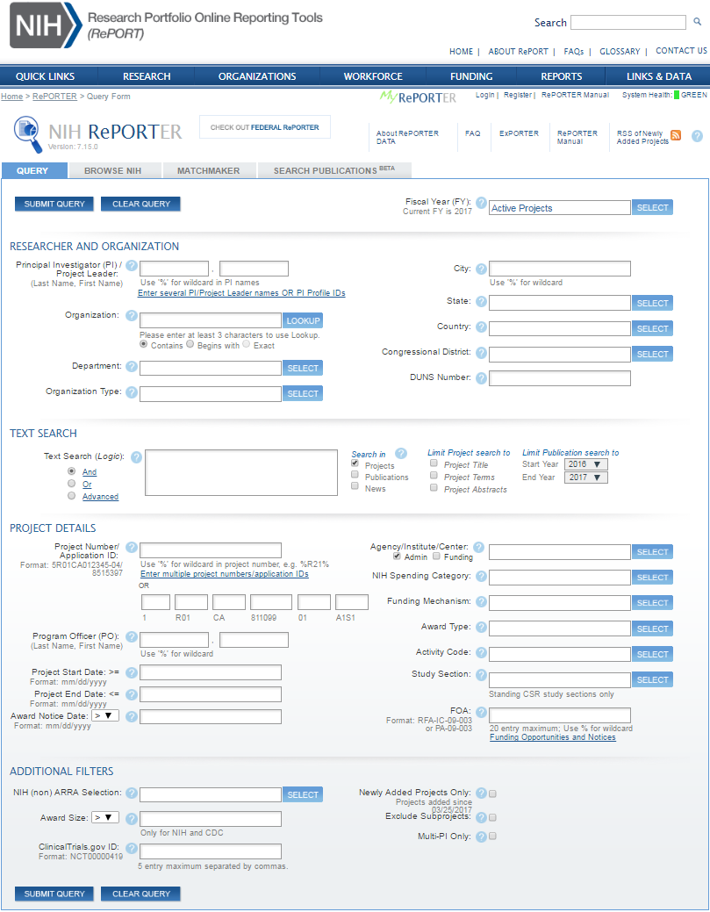
RePORTER (RePORT Expenditures and Results)
http://projectreporter.nih.gov

Slide 26
Writing your grant application
Some do’s, don’ts, and pointers

Slide 27
R01 Applications
Hypothesis- or Discovery-driven research grant
Individual or multi-Principal Investigator (PI or MPI)
Up to 5 years in duration
Budget: up to $250K modular; over $250K categorical
Published and/or preliminary data to justify scientific premise
Preliminary data not required for New PI/ESI, but…

Slide 28
Are you a new investigator (NI), an early stage investigator (ESI)?
Pertains to R01 applications
NI - never has been awarded a R01
ESI – never been awarded a R01 and is within 10 years of terminal degree
Does it make a difference?
  In a study section, NI and ESI R01 applications are clustered and reviewed together
  At the institute level, ESI and sometimes NI applications have a preferential ‘payline’

Slide 29
Are you a new investigator (NI), an early stage investigator (ESI)?
Preliminary data not required for New PI/ESI, but…
Published and/or preliminary data is required to support your scientific premise
Feasibility is required for the experimental design
  Published and/or preliminary data
  Expertise and publications of a collaborator
    Include biosketch and letter of support

Slide 30
Do I Contact NIH Before Applying?
Yes!
Mandatory
Application with budget >$500,000 direct costs for any single year
R13 Conference Grants
Optional
When RFA’s request a Letter of Intent
Always Recommended
When you think about applying for any grant

Slide 31
R21 and R03 Applications
Not every IC accepts these funding mechanisms
  NINDS R21 PA-18-358
Do not require preliminary data but require feasibility data
R21 – 2 years for a total of $275,000
  ‘High-risk, high-reward’
  Create a new tool/model for the community
  Obtain preliminary data for R01
  Not a ‘mini’ R01
  Not “easier” to obtain than a R01
R03 – 2 years for $50,000/year
  To obtain preliminary data and then write a R01
Notes:
Make sure check with IC – look at ICwebsite for guidelines

Slide 32
The NIH Application for RPGs
Introduction – one page (for resubmissions)
Specific Aims – one page
Research Strategy
  12 pages (for R01s), 6 pages (for R21s and R03)
    Significance
    Innovation
    Approach – includes preliminary data, progress report

Slide 33
New guidelines!
Scientific Premise - a discussion of scientific premise (in Significance, also can be in preliminary data)
Scientific Rigor - how the design and methods will achieve robust, unbiased, and reproducible results (in Approach including preliminary data)
Biological Variables, e.g., sex, are factored into the research design (in Approach)
Authentication of Key Biological Variables (Include as an attachment; not in research strategy; not scored)
https://grants.nih.gov/reproducibility/index.htm

Slide 34
Scientific Premise
The scientific premise for an application is the research that is used to form the basis for the proposed research question(s).
Describe the general strengths and weaknesses of the prior research being cited as crucial to support the application.
  Could include attention to the rigor of the previous experimental designs, as well as the incorporation of relevant biological variables and authentication of key resources.
https://grants.nih.gov/reproducibility/index.htm

Slide 35
When is the right time to submit an application?
Balance between:
  Getting your lab started/keeping the work going
  Submitting at the most optimal time
    Submit when you think the application will be the most competitive
Consider:
  Your publication record
    Papers must be published/in press (not submitted)
    Do they pertain directly to the aims?
  Your preliminary and feasibility data
  Recruitment of collaborators
Notes:
Hard to go from a N.D. to a fundable score
Reviewers have a memory when it comes to poor (and good) applications
Proposing something that reviewers might be skeptical about; then get a paper explaining your work published before submitting
Playing in the deep-end of the pool

Slide 36
What study section should review your application?
Go to CSR website (https://public.csr.nih.gov/studysections/pages/default.aspx)
Talk to your PD
Include an Assignment Request Form with the application (no more cover letters); suggest:
  An institute for potential funding
  A study section for review
  Specific areas of scientific expertise (but no names!)
  Reviewers that should not be involved in the review
Notes:
Need a specific reason – being a competitor is not one – and this must be stated specifically in your cover letter.
Remember everyone on your applications (even most letters of support) result in those people being excluded (in most cases) from reviewing your application. Don’t paint yourself into a corner.
In a cover letter with many exclusions of people that should not review your application will reflect negatively on the PI unless strong and legitimate reasons for exclusion are given. It can be perceived to be cherry picking otherwise.
Speak to SRO about rules for disqualifying a potential reviewer

Slide 37
What reviewers look for in an application?
A clean, well-written, easy to follow application
  Significance and impact
  A strong premise leading to exciting ideas
  Clarity of the project’s rationales and goals
  Realistic aims and timelines
  Rigorous experimental approaches
  Noted limitations of the study
  Reasonable alternatives
  Helpful figures
Notes:
In thinking upon what one of your peers might generally look for as a reviewer of an application keep the following practical ideas in mind:

Slide 38
Will you be in trouble if the study is:
Discovery-driven? No, but you need to:
  Describe the rationale for the aim and how it will provide the foundation to follow up with more mechanistic questions
  *Have a defined plan for prioritizing large amounts of data
  Describe next steps
  Is not disease based? Basic research is supported:
  Place the work in context as to how it will propel the field forward
  Emphasize its significance
Not immediately translational? No,
  But if you discuss the potential translatability of a study it becomes fair game for reviewers to disagree
Notes:
Added my thoughts in red

Slide 39
How do you best set up your Specific Aims?
  You need to engage the enthusiasm of the reviewer
  May be only page read by some reviewers (not primary)
  No right or wrong way but…
  Don’t bury the lead
    Focus on the overall IMPACT of your work
  State the hypothesis and provide the aims
    Do not spend time/space telling reviewers how you will do the aim
    Rather, tell reviewers what the results will mean
Notes:
If the reviewers aren’t engaged and excited after reading your aims page, it will be an uphill climb to capture their enthusiasm

Slide 40
What are some Do’s?
Do start early
Do enlist collaborators, if appropriate
Do make sure you understand the funding mechanism
Do submit when the application will be the most competitive
Do show feasibility (for new PIs preliminary data is not required but…)
Do provide a timeline and realistic budget for the work proposed; Be sure to justify
Do pay attention to other scorable items (e.g., Vertebrate Animals) and non-scorable items
Notes:
Minor changes. I think you can just say the following but it doesn’t need to be on the slide.
Don’t assume the reviewer will figure this out
Can be discovery-driven
Not every experiment works

Slide 41
Some more Do’s
Do focus on Impact
Do provide a strong premise
Do show evidence of Rigor and Reproducibility
Do provide alternative possibilities and technical limitations
Do take the reviewers by the hand and lead them to where you would like them to go
  Reviewers don’t think about your research 24/7
  Make it reviewer friendly (helpful figures)
Notes:
the panel will not like it if you have over-estimated the cost.

Slide 42
What are some ‘Don’ts?
Don’t let the reviewers characterize your application as either ‘descriptive’ or one that makes ‘incremental’ advances
  Emphasize the big picture of your studies in terms of impact and innovation
Don’t write a diffuse, unfocused proposal
Don’t propose an overly ambitious application
Don’t propose aims that are dependent on each other
Don’t write with the assumption everyone knows as much about the subject as you do
Notes:
If there are descriptive parts, tell them that you know it is descriptive but:
You have to characterize a particular biological system before getting to more mechanistic aspects
Emphasize the big picture of your studies

Slide 43
Some more ‘Don’ts
Don’t assume your hypothesis is correct and all experiments will work perfectly
  Include a section, e.g., ‘potential problems and alternative explanations’
Don’t be unaware of changes to NIH applications
  e.g., premise, rigor and reproducibility
Don’t show evidence of poor ‘grantmanship’
  Small figures, no ‘white spaces’ in application
Don’t repeat same mistakes as you did in earlier applications
Notes:
An application that has no ‘white’ spaces
Spelling and grammatical errors
Figures that are too small to be seen easily

Slide 44
Summary Statement
PROGRAM CONTACT: Stuart Moss
(301) 435-6979 mossstua@mail.nih.gov
SUMMARY STATEMENT ( Privileged Communication )
Release Date: 03/27/2016
Application Number: 1 R21 HDXXXXX-01
Principal Investigator CURIE, MARIE, PHD
Applicant Organization: University of Paris
Review Group: CMIR Meeting Date: 03/23/2016
RFA/PA: PA11-261
Council: MAY 2014 PCC: RS -SM
Requested Start: 07/01/2016
Project Title: The Effect of Radium on the Testis
SRG Action: Impact/Priority Score: 30 Percentile: 22 #
Human Subjects: 10-No human subjects involved
Animal Subjects: 30-Vertebrate animals involved –no SRG concerns noted
*
Notes:
Pink sheets
Impact/priority score final scores from everyone at the table, multiplied by 10, no math rel’nship to criterion scores given in the SS.
Stuart, I changed the font of this slides title as it was different from all the others.

Slide 45
Priority/Impact Score and Percentile
Applications in the bottom half of pre-discussion average scores are not discussed: ND (++)
  ND – fall into bottom 50% based on preliminary scores
All discussed applications receive a priority/impact score (PS)
  PS = the average of all final scores, multiplied by 10
Most priority/impact scores are ranked by converting them to a percentile
  ICs fund to a certain percentile based upon their budgets (and ‘other’ factors)
Notes:
I get a lot of questions from Pis as to what the percentile actually is and what works the best in them getting it is to tell them it is their ranking within the group of applications discussed.

Slide 46
What is the OVERALL IMPACT of an application?
Two questions drive reviewer determination about the likelihood that the proposed studies will have a strong and sustained impact on the scientific field
  Should they do it?
  Can they do it?
The overall impact is NOT mathematically related to individual criteria scores.

Slide 47
Should they do it?
Are the specific goals of the application based on a well-reasoned premise so an important and significant advancement to the field is likely?
  Significance and innovation
  Is the premise strong?
  Not an incremental advance in the field

Slide 48
Can they do it?
Considering the approach, the investigators and the environment, are the goals of the proposal likely to be met?
  Is the experimental strategy sound and rigorous?
  Is there confidence that the research will be reproducible?
  Have potential confounding variables been considered?

Slide 49
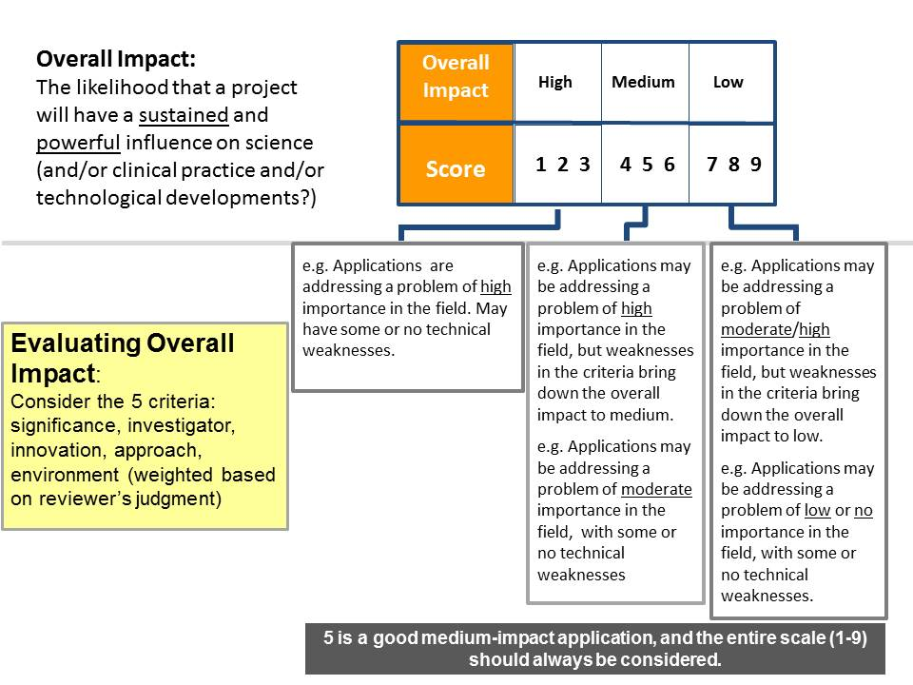
Scoring
Notes:
Don’t spend much time on this just say 1-9 scale

Slide 50
Summary Statement
RESUME AND SUMMARY OF DISCUSSION:
Written by the SRO based on the final outcome of the discussion, summarizes strengths & weaknesses mentioned by all reviewers, highlights areas of concurrence & disagreement between reviewers.
CRITIQUE 1
Significance: 3
Investigator: 1
Innovation: 1
Approach: 4
Environment: 1
Overall Impact:
Written by the individual reviewer to summarize their opinion on the overall strengths and weaknesses of the application.
These scores are indices only. They have
no mathematical relationship to the priority score.
Notes:
Each reviewer give their overall impact and scores for the 5 criteria with strengths and weaknesses

Slide 51
Significance
Does the project address an important problem or a critical barrier to progress in the field?
Is there a strong scientific premise for the study?
If the aims of the project are achieved, how will scientific knowledge and/or clinical practice be advanced?

Slide 52
Investigator
Does the investigator(s) have the training and skills necessary to perform the proposed studies?
Does the investigative team bring complementary and integrated expertise to the project?
Use your biosketch to describe your major contributions to the field and explain any mitigating circumstances that might have impeded recent progress

Slide 53
Innovation
Can refer to either ideas or methodology
  Does the application challenge and seek to shift current research or clinical paradigms?
  Are the approaches novel to one field of research?
‘Value added’:
  Innovation generally has the least negative impact on overall impact score, however, a truly innovative approach can have a strong positive impact.

Slide 54
Approach
Are the overall strategy, methodology and analysis well-reasoned and appropriate to accomplish the specific goals?
Have the investigators presented strategies to ensure a robust and unbiased approach for the work?
Have the investigators presented adequate plans to address relevant biological variables for studies in vertebrate animals or human subject, e.g., sex?
Are potential problems and alternative strategies presented?
Can often be the most straightforward type of criticism to deal with because often it is “fixable”

Slide 55
Environment
Does the scientific environment in which the work will be done contribute to the probability of success?
Do the proposed experiments take advantage of the unique features of the scientific environment or employ useful collaborative arrangements?

Slide 56
Consider the criteria scores carefully
The written comments and summary of discussion will tell a more complete story
However, pay special attention to Significance and Approach
  Low significance, no matter what the other scores are, might be hard to fix
  High significance but weak approach may be fixable

Slide 57
Other Considerations
Scoreable items
  Vertebrate Animals
    Address four points
  Human Subjects
    Inclusion/exclusion criteria
    Women/children/minority
    Power analysis
  Biohazards
Non-scorable items
  Budget, time, resource/data sharing
  Authentication of Key Biological Resources

Slide 58
Writing a K application
Career Development Award
  K99/R00
  Also Ks for clinicians at different career stages
Review criteria
  Candidate
  Mentor(s), Co-mentor(s) – mentoring team
  Career development plan/career goals and objectives
  Research Plan
  Environment and Institutional Commitment

Slide 59


After Peer Review
Priority Score and Percentile
Summary Statement Released
Discuss with PO
2nd Level Review (Advisory Council)
Notice of Grant Award
Resubmission/
Rethinking
Notes:
2-4 weeks after review posted in commons
All appls, even ND
I just centered this slide.

Slide 60
If you have to resubmit…
Take a deep breath and wait until you get the critique
Speak to your PD
  If the application was discussed, they have notes
  Can you respond appropriately?
  If not discussed, maybe consider an application that moves in a different direction
One page introduction to a resubmitted application to address concerns
  Don’t be combative
Don’t resubmit too quickly
Don’t assume you will get the same reviewers
Notes:
Help you understand the level of enthusiasm

Slide 61
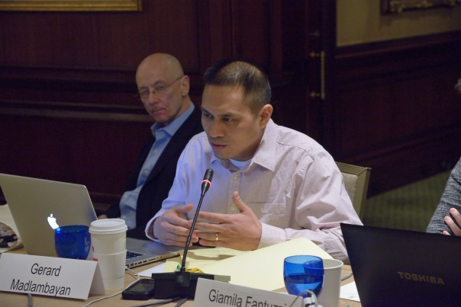

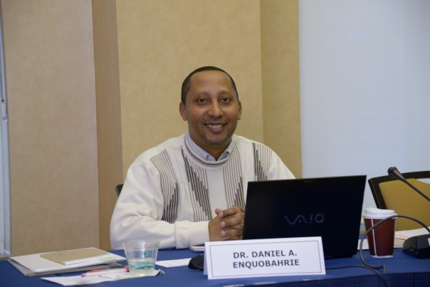
Gain Review Experience:
Early Career Reviewer Program
Train and educate qualified scientists to become critical and well-trained reviewers
Expose investigators to the peer review experience to help make them more competitive as applicants
www.csr.nih.gov/ECR

Slide 62
NIH Grant and Review Information
National Institutes of Health: http://www.nih.gov
  Office of Extramural Research
  http://www.nih.gov/grants/oer.htm
  Grants Policy
  http://www.nih.gov/grants/policy/policy.htm
  ‘Open Mike’ https://nexus.od.nih.gov/all/category/blog/
Center for Scientific Review: http://www.csr.nih.gov
  Resources for Applicants
  http://www.csr.nih.gov/ResourcesforApplicants
  CSR Study Section Descriptions
  http://public.csr.nih.gov/StudySections
  CSR Rosters and Meeting Dates
  http://public.csr.nih.gov/RosterAndMeetings

Slide 63
Final Things to Remember
Work with your SRO and PD
  They can both assist you but in different ways
Plan, write and get feedback early
Focus on the impact of the research
If asked to be an ad hoc reviewer, say ‘Yes’
Subscribe to NIH Guide LISTSERV:
  Official publication for Grant Policies, Guidelines and Funding Opportunities
    http://grants.nih.gov/grants/guide/listserv.htm

Slide 64


PA-18-622
Disease Mechanisms of Prenatal and Pediatric Hydrocephalus (R01)
The purpose of this funding opportunity announcement (FOA) is to support hypothesis-driven research of prenatal and pediatric hydrocephalus.
Support hydrocephalus research projects that examine the developmental etiology (intrinsic factors including genetics) and acquired etiology (extrinsic factors including hemorrhage and infection) of prenatal and/or pediatric hydrocephalus.
Studies should focus on understanding the molecular, cellular and developmental mechanisms involved in the pathogenesis of prenatal and/or pediatric hydrocephalus.
Clinical trials – not allowed.
Standard due dates apply.

Slide 65
PA-18-623
Tools to Enhance the Study of Prenatal and Pediatric Hydrocephalus (R21)
Encourage research grant applications that propose to develop or substantially modify existing cutting-edge tools that will advance prenatal and/or pediatric hydrocephalus research.
The primary objective is to remove barriers to hydrocephalus research that are due to scarcity of tools to investigate both the disease mechanisms and alternative therapies (non-shunt) in a rigorous manner.
Applications should aim to transform the field of prenatal and/or pediatric hydrocephalus research by generating tools including animal and cell models, novel methods and innovative technologies that will be widely used throughout the neuroscience community to understand disease mechanisms and/or developing therapeutics.
Clinical trials – not allowed.
Standard due dates apply.

Slide 66

Promote analytical and clinical validation of existing candidate biomarkers
Catalyze biomarker research through centralized information on NIH biosample and imaging repositories, data collections, and best practice consensus standards/methods
Funding Opportunities
Analytical Validation of a Candidate Biomarker for Neurological Disease
To establish that performance characteristics of biomarker measurement or endpoint are acceptable for intended use
PAR-18-549 (U44) and PAR-18-550 (U01)
Clinical Validation of a Candidate Biomarker for Neurological Disease
To support rigorous clinical validation of candidate biomarkers using retrospective and/or prospective methods
PAR-18-548 (U44) and PAR-18-664 (U01)
Notes:
Feb 2018 – FOAs posted Feb 14, 2018
https://www.ninds.nih.gov/Current-Research/Research-Funded-NINDS/Translational-Research/Neuro-Biomarkers
Purpose: Facilitate the development of high quality biomarkers to improve the quality and efficiency of clinical research (Phase II and beyond)
Overview
NINDS Biomarker Program will:
Promote the analytical and clinical validation of existing candidate biomarkers in a manner that is consistent with FDA guidelines and publications developed in collaboration with the NIH and the pharmaceutical industry
Catalyze biomarker research through the centralization of information on NIH-biosample and imaging repositories, information technologies, data collections, and best practice consensus standards and methods
Support research that incorporates high levels of quality, evidentiary standards, and implementation of best practices and consensus methods to ensure that data is useable and reproducible
Funding Opportunities
Current new funding opportunities focus on the advancement of candidate biomarkers to later stages of development, including analytical and clinical validation.
Note: Applications directed at developing biomarkers associated with pain or pain therapies are permitted to include aims related to biomarker discovery and identification in addition to aims related to analytical and/or clinical validation. See notice NOT-NS-18-043.
Analytical Validation of a Candidate Biomarker for Neurological Disease
PAR-18-549: U44
PAR-18-550: U01
The purpose of these Funding Opportunity Announcements (FOA) are to support rigorous analytical validation of candidate biomarker measures or endpoints in a manner that is consistent with FDA guidelines. Analytical validation establishes that the performance characteristics of the biomarker measurement or endpoint are acceptable for its intended use. These FOAs assume that 1) a candidate biomarker has already been identified, 2) assay technology has already been developed, and 3) a working hypothesis regarding context of use is in place. The goal of these FOAs is to facilitate the advancement of robust and reliable biomarkers of diseases that fall within the mission of NINDS to application in clinical trials and practice (Phase II clinical trials and beyond).
Clinical Validation of a Candidate Biomarker for Neurological Disease
PAR-18-548: U44
PAR-18-664: U01
The purpose of these Funding Opportunity Announcements (FOA) are to support rigorous clinical validation of a candidate biomarker using retrospective and/or prospective methods in a manner that is consistent with the purpose of the biomarker. These FOAs assume that: 1) a candidate biomarker has already been identified, 2) an analytical method has been developed and validated that is consistent with the purpose of the biomarker and 3) a working hypothesis regarding context of use is in place. The goal of these FOAs is to facilitate the advancement of robust and reliable biomarkers of diseases that fall within the mission of NINDS to application in clinical trials and practice (Phase II and beyond).

Slide 67
Good Luck!
Questions?

Slide 68
Research Training and Career Development Timeframe
Research Awards
Career Stage
‘Formal’ Training/Career Awards
Pre-Bac
Pre-Bac Institutional Training Grant (T34)
GRADUATE/
MEDICAL
STUDENT
Predoctoral Institutional Training Grant (T32)
‘Informal’ Training
and Career
Development on
RPGs and
Supplements
Predoctoral Individual NRSA (F31)
Predoctoral Individual MD/PhD NRSA (F30)
Postdoctoral Institutional Training (T32)
Postdoctoral Individual NRSA (F32)
POST
DOCTORAL
NIH Pathway to Independence (PI) Award (K99/R00)
Mentored Research Scientist Development Award (K01)
Mentored Clinical Scientist Development Award (K08)
Mentored Patient-Oriented RCDA (K23)
Mentored Quantitative RCDA (K25)
Institutional Mentored Clinical Scientist Award (K12)
EARLY
Small Grant (R03)
AREA Grant (R15)
Exploratory/Develop-ment Grant (R21)
CAREER
MIDDLE
Research Project Grant (R01)
Midcareer Investigator Award in
Patient-Oriented Research (K24)
SENIOR
Senior Scientist Award (K05)
Notes:
RCDA – Research Career Development Award

